Slide 1
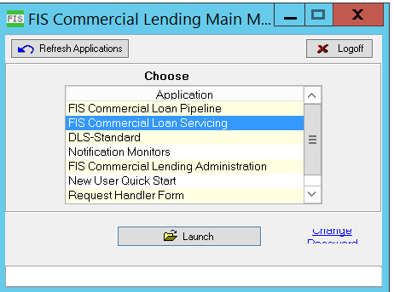
ACBS OVERVIEW
ACBS
ACBS which stands for Advanced Commercial Banking System is a flexible suite of tools leveraged by financial institutions to manage the origination, servicing and reporting of their commercial lending activities.
ACBS COMPONENTS
ACBS is comprised of two main components that support daily use of the application. They are
ACBS Servicing
DLS Standard
ACBS Servicing
The main component of ACBS that users interacts with entering and servicing Customer, Facility and Loan records in user friendly interface. This is the environment that end users work in.
In other words, servicing means ,The input of facility and loan details for maintenance and tracking over the life of the credit agreement.

Slide 2
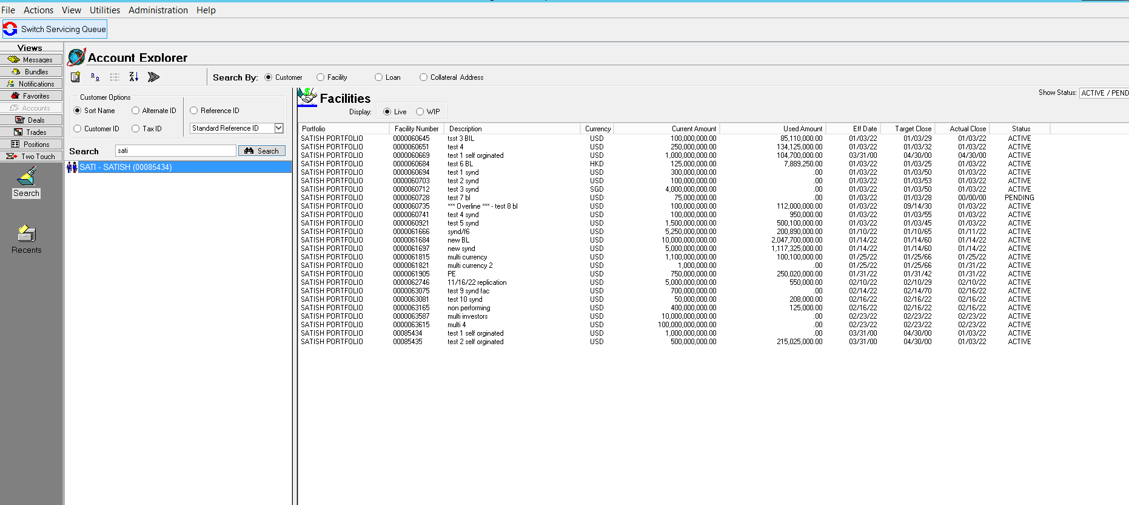
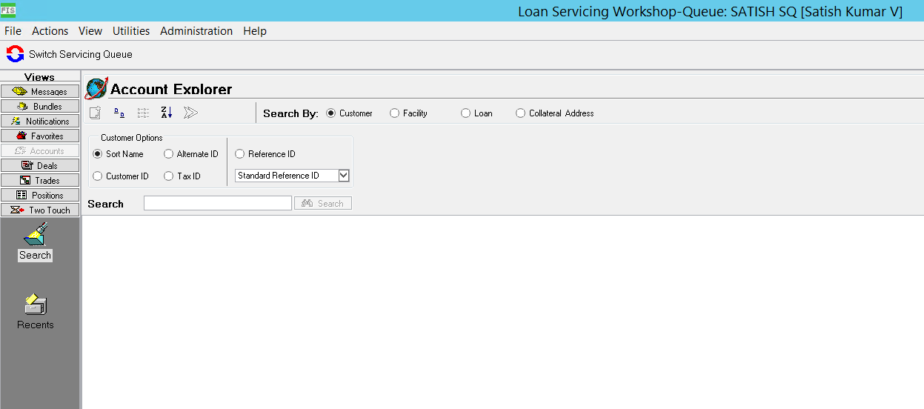
ACBS Servicing Uses
ACBS serves front and back-office users in performing commercial lending tasks for all types of customers,facilities,deals and loan activities.
Servicing Queues:
To help manage workflows and increase the visibility of users activities, each user in ACBS servicing is assigned to one or more servicing queues.

Slide 3
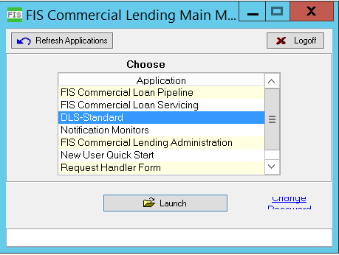
ACBS OVERVIEW
DLS Standard
The component houses the majority of the setup and system administration functions in a text-based format. The actual database containing the information for records displayed in.
ACBS servicing is also housed in DLS standard.

Slide 4




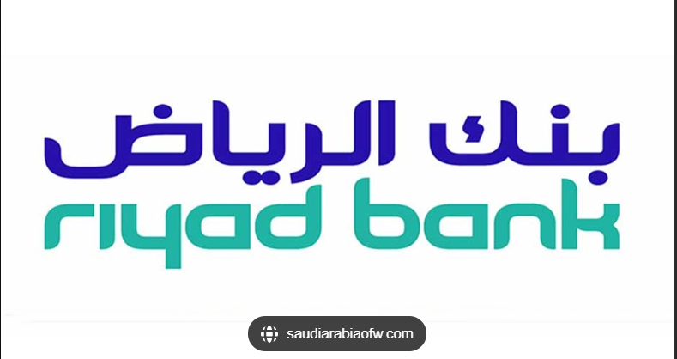
OUR CLIENTS
Clients in ACBS are categorized into two.They are
ASP clients
Non-ASP clients
ASP Clients:
ASP(Application Support Provider) clients have their own internal dedicated team which will support ACBS application. They will come back to FIS only if their internal team cannot handle on own.
Clients like Bank of Ireland,Lyoyds bank, First Horizon bank etc are part of ASP clients.
Non-ASP Clients:
Non-ASP clients don’t have any internal team to support ACBS they completely rely on FIS for application support.
Clients like Riyad bank, Standard Chartered bank, Emirates bank etc. are part of Non-ASP clients

Slide 5
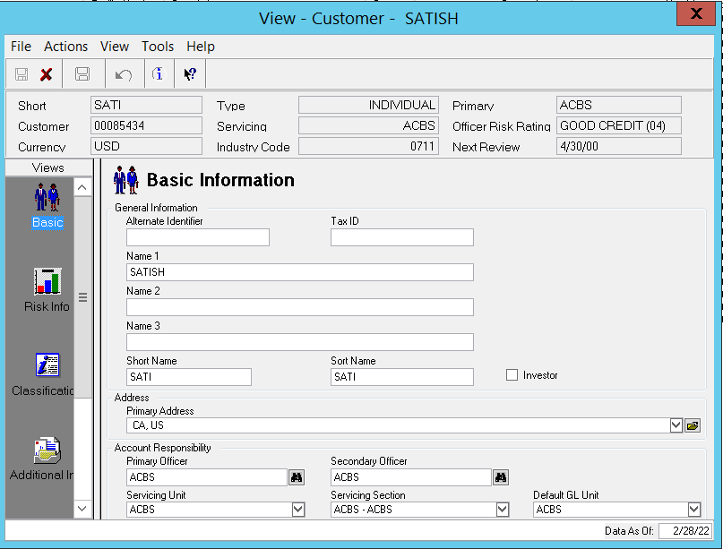
CUSTOMER
A master customer record must be established for every interested entity(business,individual,guarantor,syndicate bank, participant bank etc.)
This record is stored in the Customer Information System(CIS) database of ACBS servicing and is essential to the creation of facilities and loan.
Following information are contained in ACBS master records.
Address
Payment instruction
Customer correspondence record
Documents(Collateral,guarantees,insurance)
External ratings
Financial statements.

Slide 6
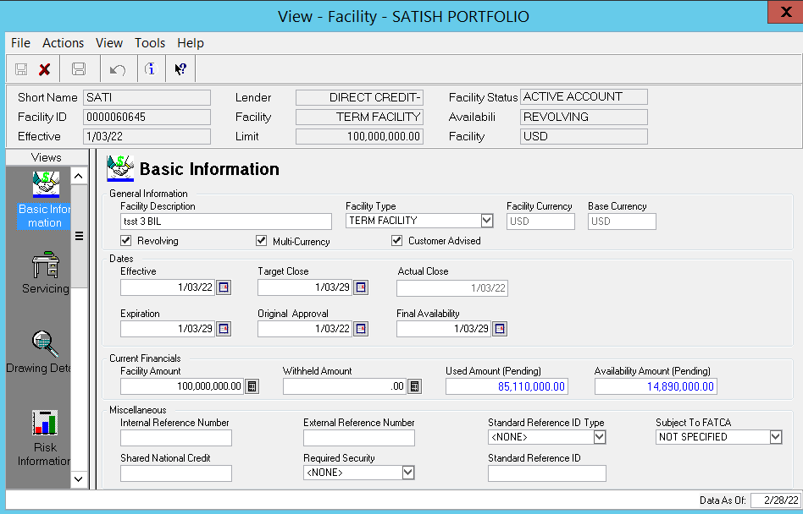
FACILITY
A facility is a formal financial assistance program offered by a lending institution to help a company that requires operating capital. Types of facilities include overdraft services, deferred payment plans, lines of credit (LOC), revolving credit, term loans, letters of credit, and swingline loans. A facility is essentially another name for a loan taken out by a company.
Following information are contained in ACBS facility
Multi currency restrictions
Covenants
Default payment instruction
Fee Schedule
Pricing options
Future limit changes
FX rate control

Slide 7
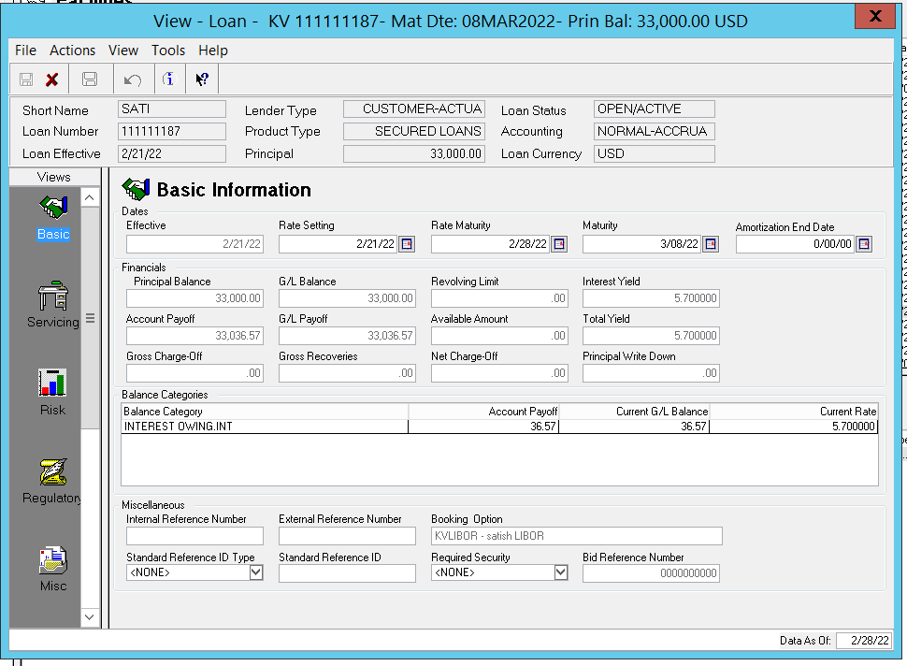
LOANS
ACBS servicing loan records are designed to contain all the relevant details used to track the loan booking,accurals and repayments throughout the credit lifecycle.
ACBS loan feature supports multiple instrument and product types.
Loan records consists of following elements
General information(Loan amount,tenure,interest rate etc)
Investor information
Accrual schedule information
Repayment schedule information
Fees
Booking of new loan in ACBS is a multi step process that starts with the creation of a new bundle.
When users create a bundle tied to a facility certain detail information of the facility will carry over
to the new loan form.

Slide 8
DLS STANDARD
DLS-Standard is the core processing engine for the ACBS product suite and unifies all information in a single repository. With DLS-Standard’s support, ACBS Servicing provides comprehensive capabilities for the following primary activities of the commercial lending business
Customer Relationship Management
Credit/Relationship Management
Risk Management
Facility Structuring, Pricing, Servicing
Agency Administration, Syndication/Participation/Sub-participation
Loan Booking
Loan Structuring, Pricing, Servicing
Transaction Entry, Approval, Reporting
General Ledger Accounting
Rollovers/Conversions
Rate Settings
Confirmations, Notifications
Audit
Inquiry
Billing, Repayment
DLS-S provides the screens accessed by ACBS Pipeline and ACBS Servicing system administrators who are tasked with setting up user privileges and tailoring the systems settings to the organization's requirements.

Slide 9
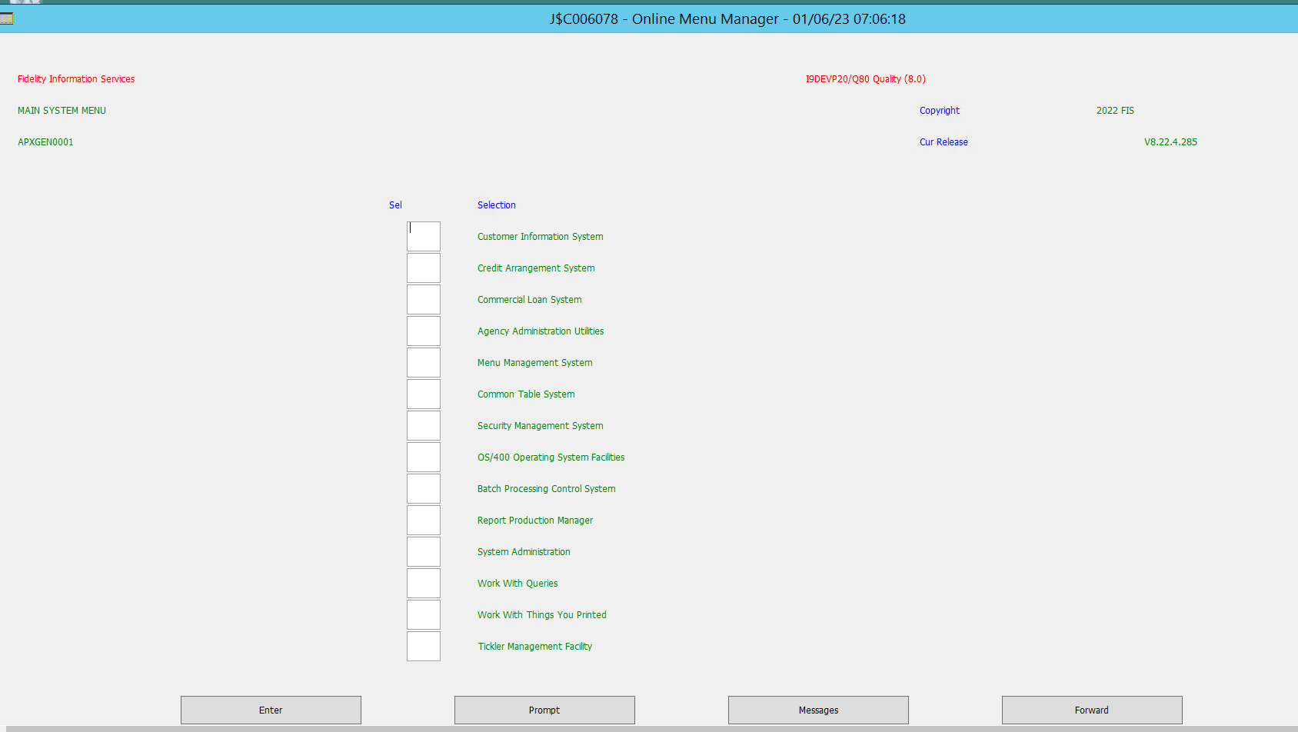
DLS STANDARD

Slide 10
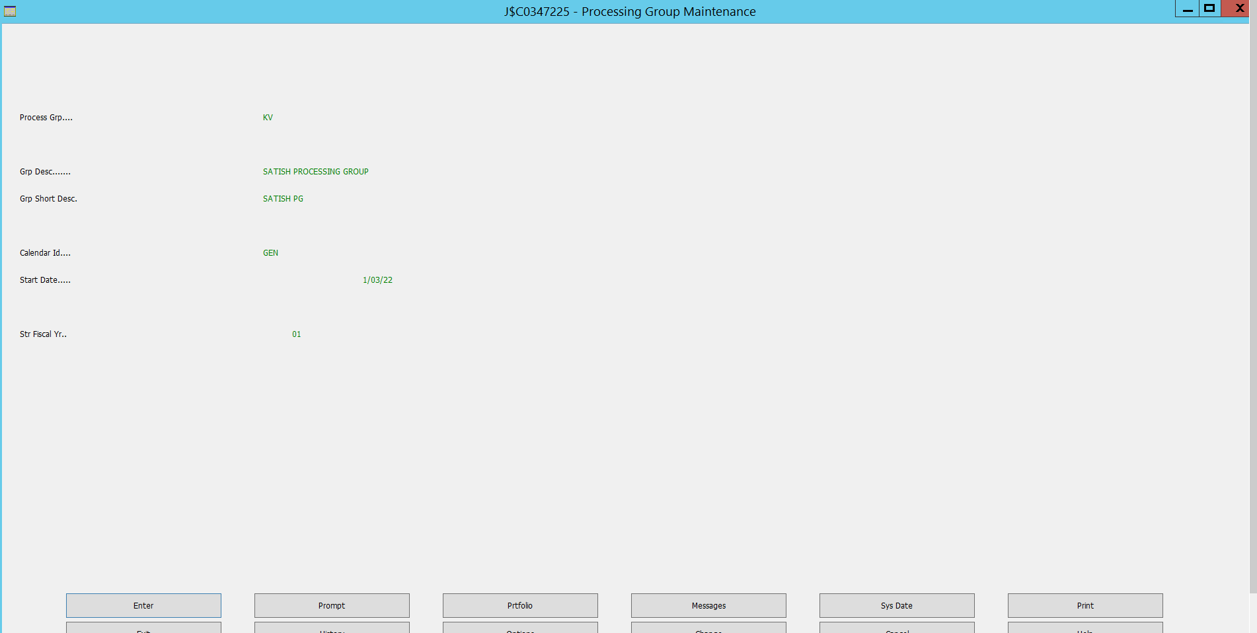
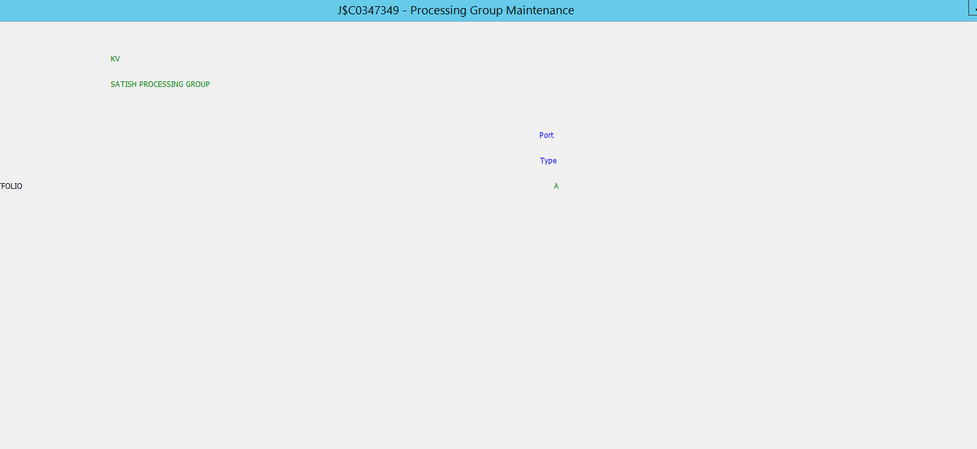
Processing Group
Processing Group:
In ACBS the highest level of Bank organization for EOD(End of Day) and reporting purposes is a processing group .EOD routines is linked to each processing group.

Slide 11
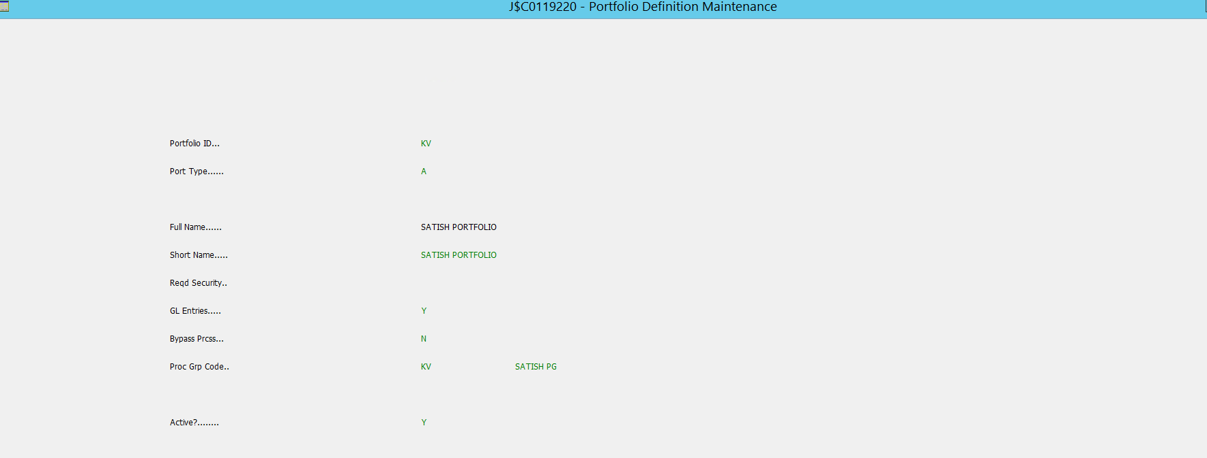
PORTFOLIO
Portfolio is the highest level of system logical grouping within the processing group. All accounts within the ACBS environment are logically grouped by portfolio. Each loan associated with portfolio within ACBS.

Slide 12
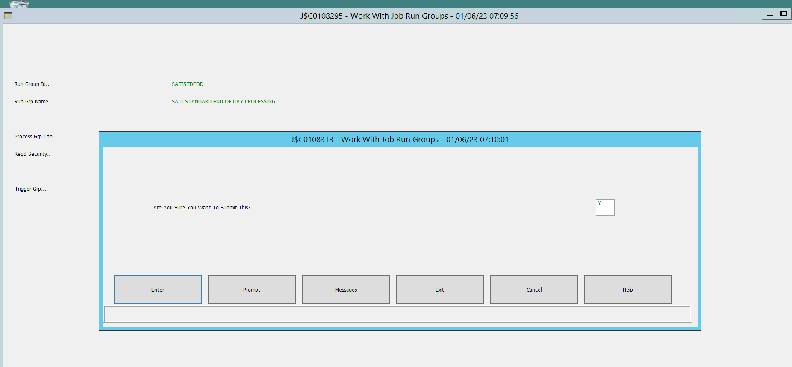
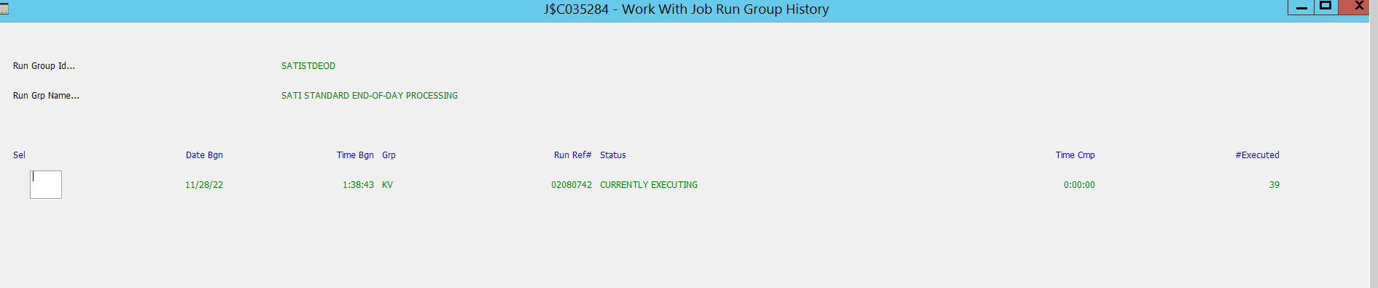
End Of Day Processing
End of Day Processing:
Each servicing queue is linked to a processing group for End of day processing. During the End of day routine, automated programs calculate and update the system records as the system date cycles to next business day

Slide 13
ACBS SERVICING LOAN WORKSHOP
Loan servicing workshop functionality focuses on the creation and maintenance of records and information used for the extension of credit. Detailed information related to borrowers,loans,facilities,participation and syndication is managed in the loan servicing workshop.
It is a powerful tool that automates loan servicing activities while eliminating data entry and process redundancies as well as the potential for data fragmentation.

Slide 14
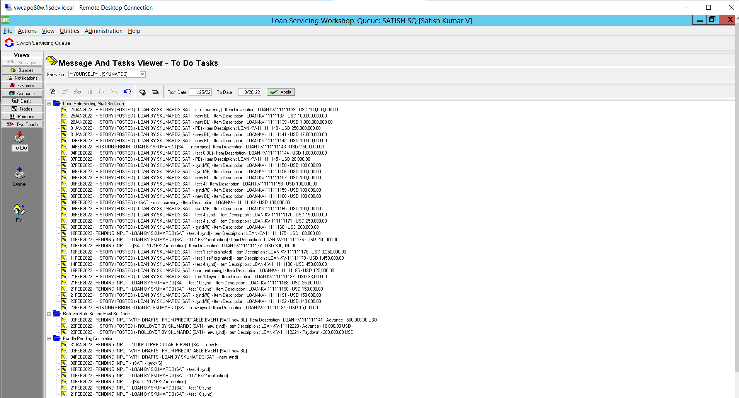
ACBS SERVICING LOAN WORKSHOP

Slide 15
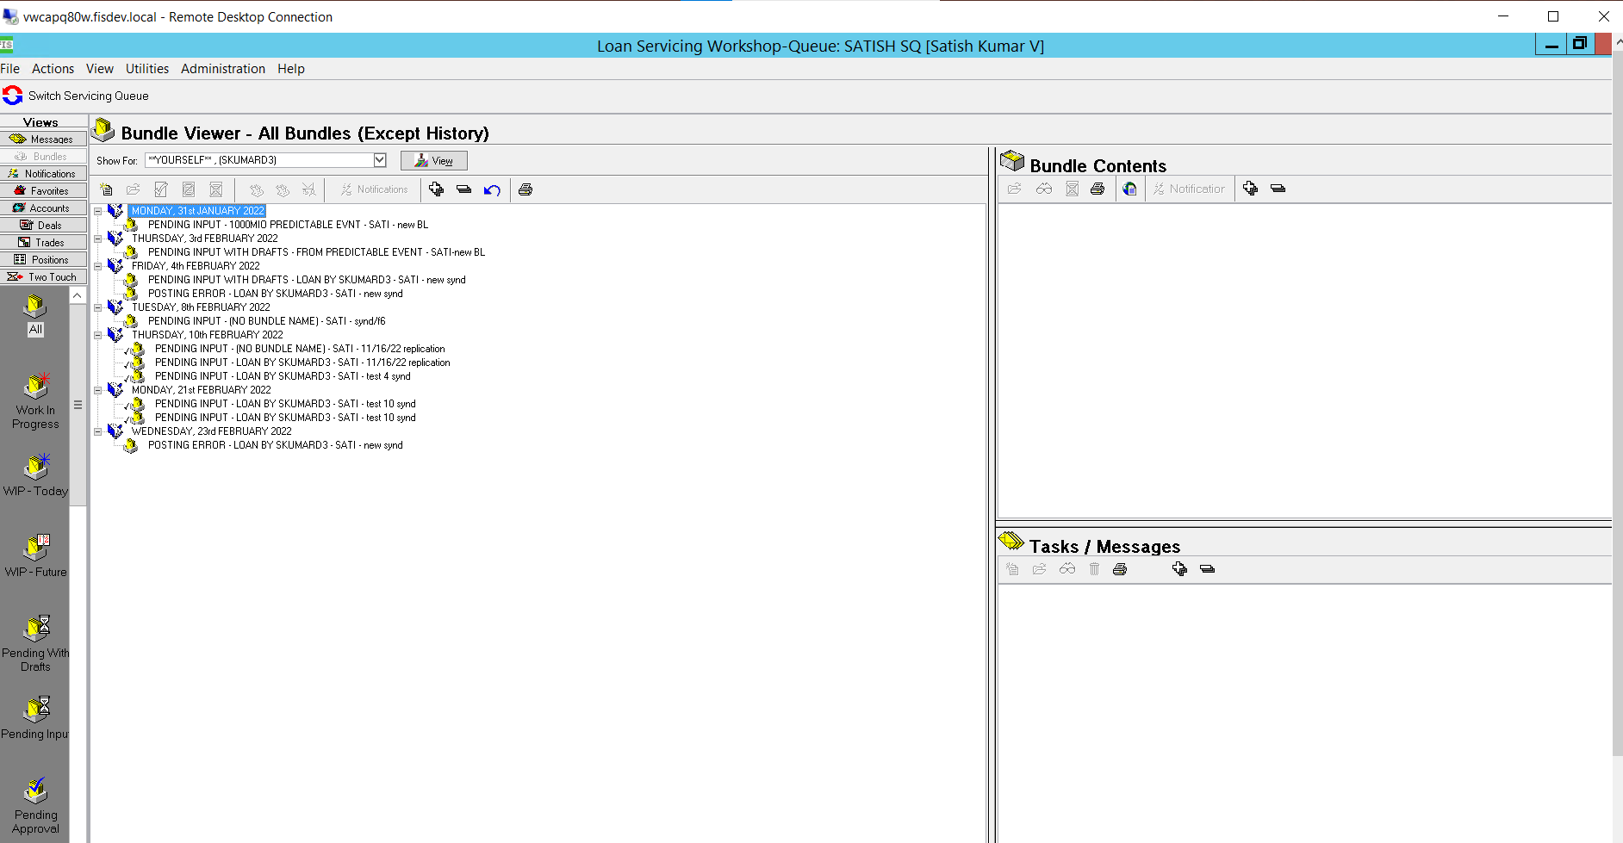
ACBS BUNDLE OVERVIEW
The Bundling feature in ACBS servicing is designed to support the multitask processing of large and small user transactions by grouping transactions into related units. Bundles provides a shared group of users with high visibility of all related transactions while work is in process and after posting. A bundle contains the logical grouping of all the components of a single servicing activity or event that are processed as bundle items.

Slide 16

ACBS GENERAL LEDGER
Posting to the GL is based on changes in financial balances(principal accrued interest, cash etc) and not specific events.
Increases are represented by positive amounts, decreases by negative amount i.E the sign of the movement is very important.

Slide 17
TRANSACTION
ACBS Servicing is a transaction-oriented application. Every action (entering a new customer or facility, modifying an accrual schedule, processing a loan payment or booking a new loan etc.) happens because a transaction code exists for that action.
ACBS servicing employs two major types of transactions
System transaction
User-Initiated transaction

Slide 18
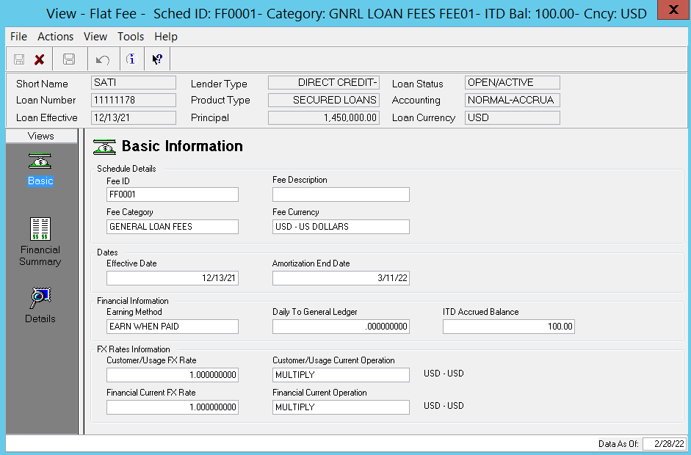
SYSTEM TRANSACTION
System transaction are “Behind the scene” transactions that occur whenever a user completes a new record or edits an existing record.These transactions occur when user saves the screen.
Examples
Entering a new customer master record
Entering a new facility fee
Changing the street number on the primary address
Adding a collateral detail record

Slide 19
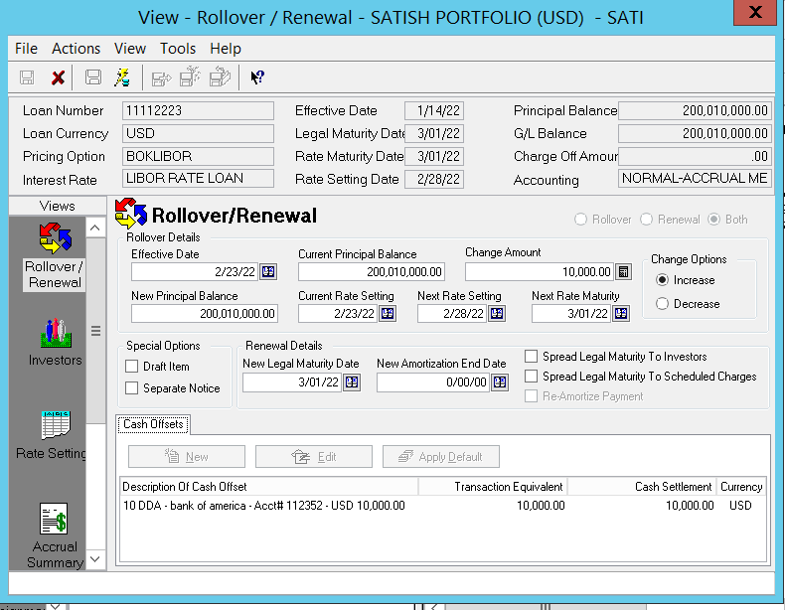
USER-INTIATED TRANSACTION
User-Initiated transaction are routine changes or corrections to existing records that impact financial balances. These transactions are entered via bundles.
Examples:
Fee Payments
Principal Payments
Rollovers
Limit increase or decrease

Slide 20
Prerequisites for i3 Series
The following configuration and conditions must be in place before the ACBS V8.0 Product Suite is installed in an iSeries environment.
Server Configuration
IBM i V7R1M0
IBM iSeries Access for Windows licensed program (ships as part of the base OS).
License Program 5770XEW1 for IBM i Access for Windows.
LANSA 13 SP2 installed.
LANSA EPCs Level 132900 installed.
LANSA Listener Subsystem configured and running. As part of the LANSA 13 SP2 installation, the listener subsystem is automatically configured and started. Update your iSeries startup job to include starting the LANSA Listener Subsystem. The default port used is 4545.
LANSA Server licenses LXX and LCE.
Creation of group profile ACBSDEV *USER class, limited capabilities *YES
Creation of ACBSGOD profile, as a member of the ACBSDEV group profile.
ACBSGOD should be USRCLS = *USER and needs no special authorities.
ACBSGOD must have authority to use the CRTJRNRCV and CRTJRN OS/400 commands.
All ACBS tables will be preloaded, and the ACBSGOD User ID is the only User ID enrolled in the ACBS security system.
ACBSGOD is used initially to grant ACBS authority to other users within the ACBS partition
User profiles making ACBS Servicing (client) connections require a job description that includes the LANSA program library (usually DC@PGMLIB) and the LANSA communications library (usually DC@COMLIB). Your LANSA program and communications libraries may be different.

Slide 21
Prerequisites for I3 Series
The library list order for the new job description should match the library list order assigned to the job description attached to the user profile that is used by the jobs that run in the LANSA listener subsystem. For example, if one library list order is DC@PGMLIB, DC@COMLIB, QGPL, QTEMP, the other library list should be the same. Differences in the library list order could result in errors when connecting to ACBS.
The library list order for the new job description should match the library list order assigned to the job description attached to the user profile that is used by the jobs that run in the LANSA listener subsystem. For example, if one library list order is DC@PGMLIB, DC@COMLIB, QGPL, QTEMP, the other library list should be the same. Differences in the library list order could result in errors when connecting to ACBS.
Verify that the LANSA data area LSERVERMAX exists in the LANSA program library (usually DC@PGMLIB). If it is not, use the following command to create it:
CRTDTAARA DTAARA(DC@PGMLIB/LSERVERMAX) TYPER(*CHAR) LEN(1) VALUE(‘ ‘)
Ensure that the LANSA DC@OSVEROP data area includes the following settings. Note: The DC@OSVEROP data area is located in the LANSA system’s data library (usually DC@DTALIB, but your site may be different).

Slide 22
Prerequisites for Windows Server
The following provides an overview of the required configuration and conditions for running the ACBS V8.0 Server in a Windows 2012 environment.
Server Configuration (Hardware)
Dual Processors or more.
Minimum 2 GB RAM (This is the absolute minimum requirement for running the ACBS Server application, over and above what Microsoft recommends for running the selected operating system, as well as any other software that is being planned for installation on this server (such as Oracle Server, for example.)
Minimum 5 GB free HDD space.
Set display to a minimum of 1024 x 768.
If the installation is done via Terminal Services, the display should be set for the session while performing the installation.
Server name of 10 characters or less.
Default ports used by ACBS:
LANSA LISTENER – 4545
Oracle Listener – 1521
Server Configuration (Software)
Windows Server 2012 R2 Standard or Enterprise Edition (64-bit).
Oracle Standard or Enterprise Server Version 12.1.0.1.0.
Oracle Client 12.1 (**32-bit version only).
▪ 12.01.00.01 ODBC driver, verified by ACBS
Note: If planning on installing Oracle Server 12 x 64 on the same server as the ACBS Application Server application, see Appendix F: Advanced Microssoft Technologies for details.

Slide 23
Prerequisites for Windows Server
ACBS Pipeline requirement: Oracle Provider for OLEDB
Microsoft Visual C++
2008 (x86 and x64) Redistributable
2010 (x86 and x64) Redistributable.
Microsoft.Net Framework v4.0.x (required for com object registration).
Microsoft Internet Explorer Version 11 or higher
LANSA 13 SP2 licenses (provided separately by LANSA)
ACBS 8.0 for Windows includes a runtime version of LANSA 13.2 and EPCs 132500, 132600, 132700, 132900, 133000, HF150811d. There is no need to install LANSA separately.
Server Configuration (Optional Software)
Depending on system configuration and business requirements, one or more Microsoft Office products may be required if the server is to be used as a client. Microsoft Office 2013 has been verified for use with ACBS V8.0 Application Server.
Microsoft Office supports the following product functionality:
Document Attachments | Free Form Notes
Word Documents | Script Writer
Excel Spreadsheets | Document Manager
HTML Documents | Notification Manager

Slide 24
Prerequisites for Windows Server
Consult with the ACBS Implementation Manager to determine which MS Office products are required to enable planned product functionality.
• MAPI-compliant e-mail program to support e-mail features.
User/Domain Requirements
Administrative rights to the server during installation
Domain User ID and password. Passwords are no longer restricted to 10 characters or less
Domain user ACBSGOD
ACBSGOD is a default application user that has all the required ACBS privileges for setup and administration. See Appendix B: Server Security for post-implementation notes regarding the default user.
Domain (or local server) group with ACBS end users as members. Local security/user rights assignments will be granted to this group

Slide 25
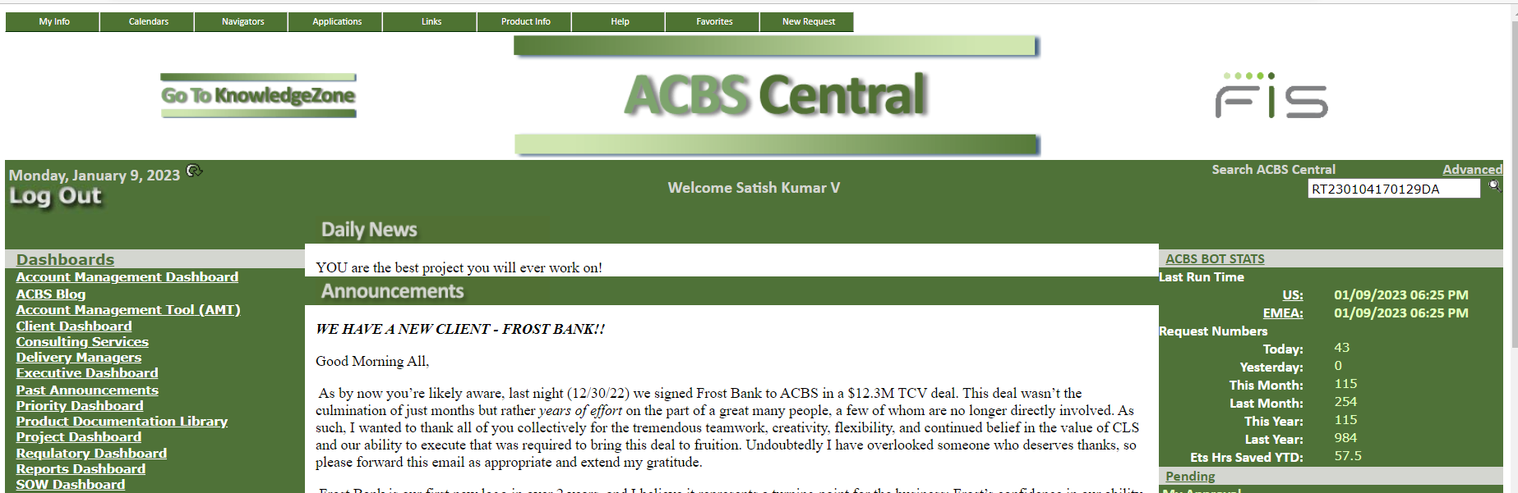
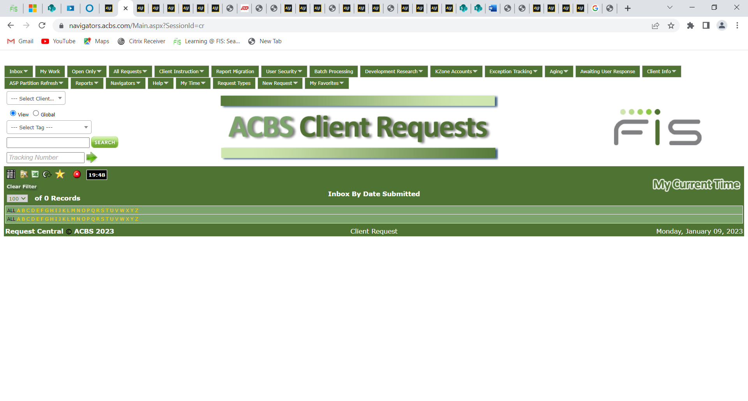
ACBS Ticketing System
We use ACBS Central ticketing system to lock our incoming client requests.
Based upon the criticality and priority we work on those request first.
After initial analyzing we further process the requests as per SOP like if there is any functional issues we will replicate those issues in our Q80 test environment. If it is non functional and need helps from other team we will raise sub request(Developmental research,ASP general,Issue resolution,Business Intelligence) based upon the issue types.

Slide 26
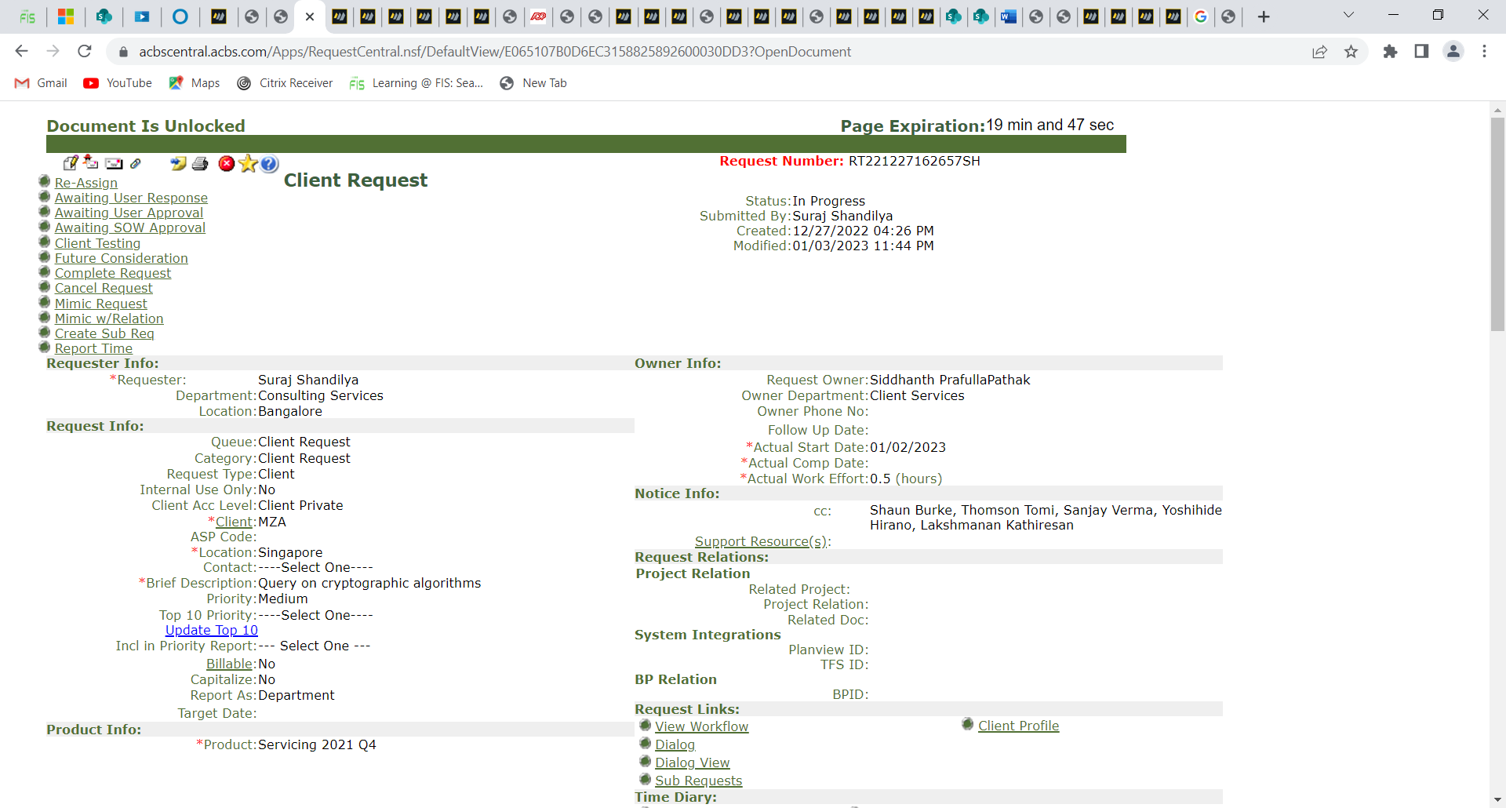
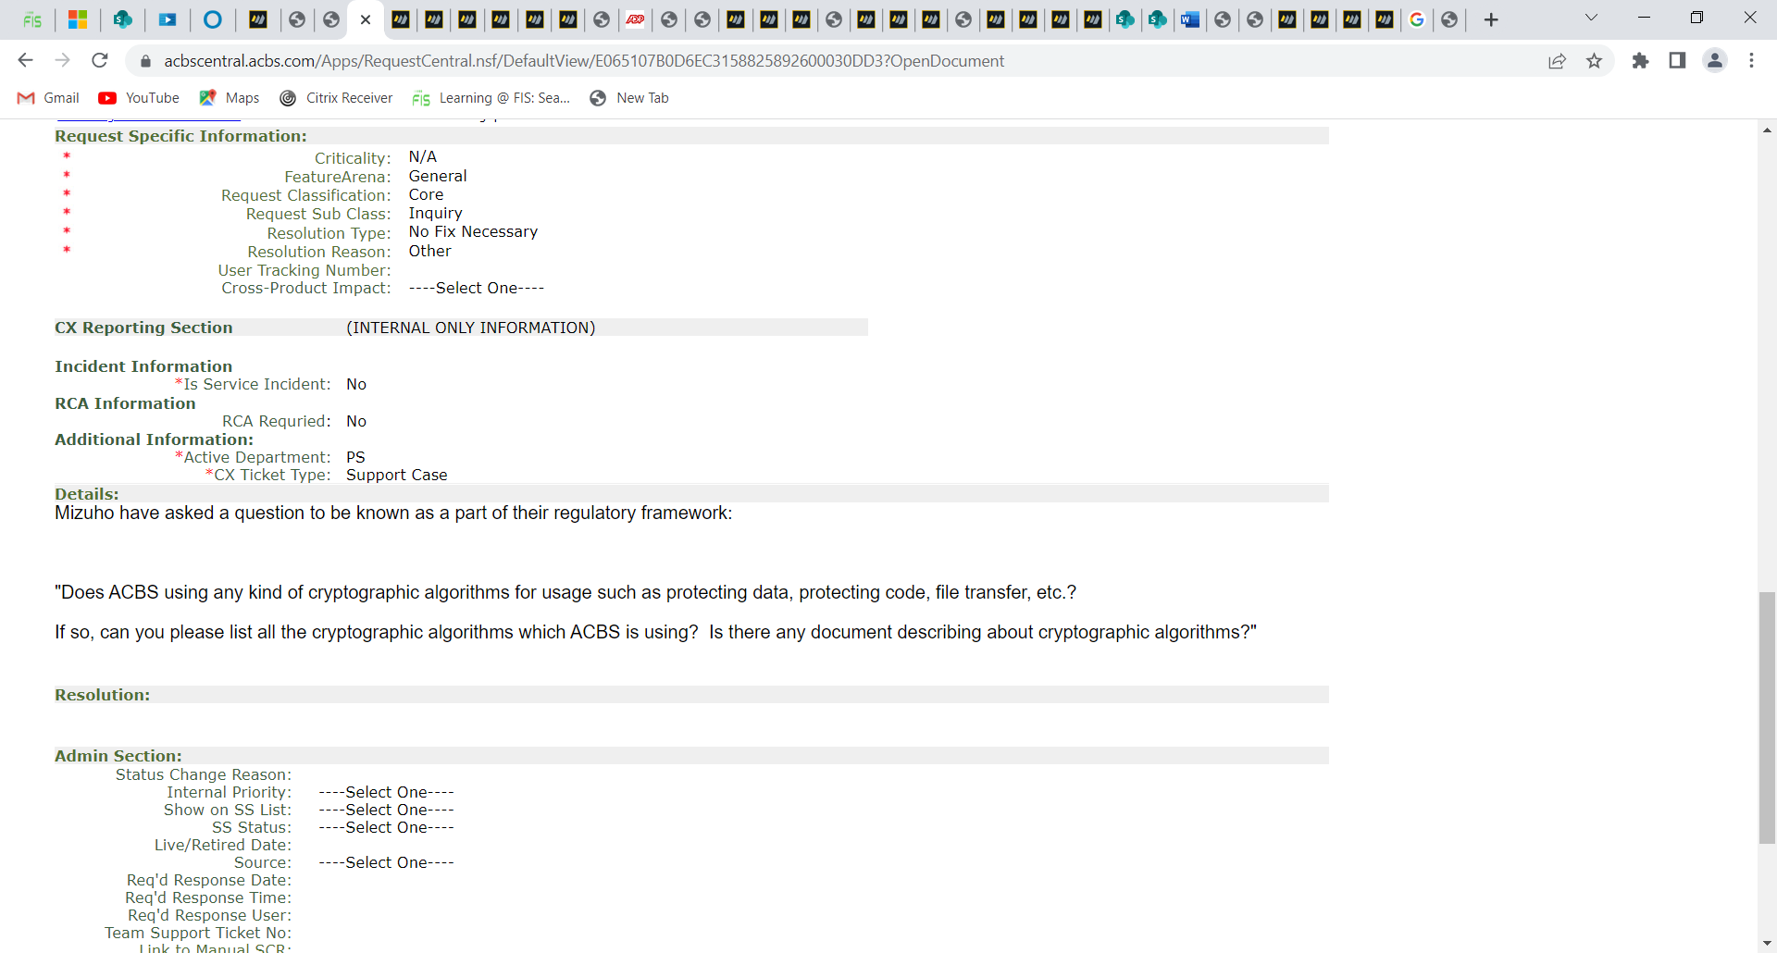

Slide 27
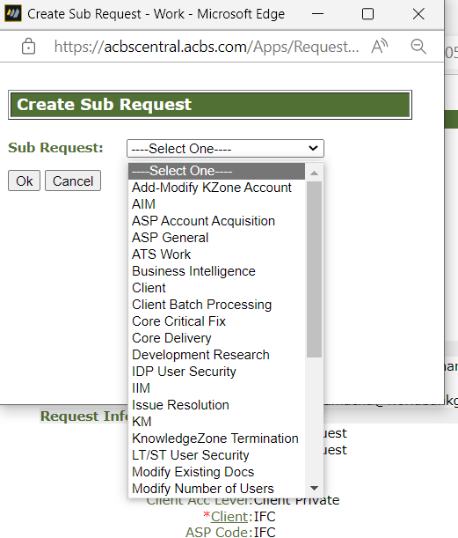
Sub Request Types

Slide 28
Thank You!

